Slide 1
Lecture #4
SOFT COMPUTING
INT508

Slide 2
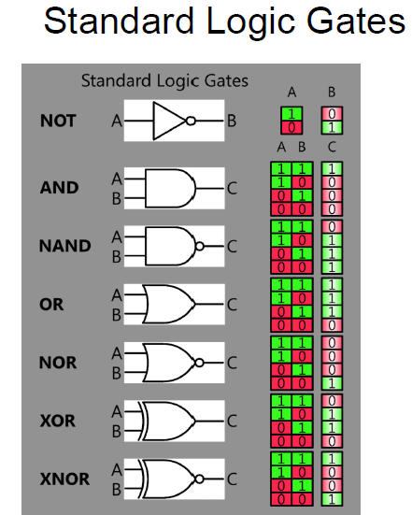

Slide 3
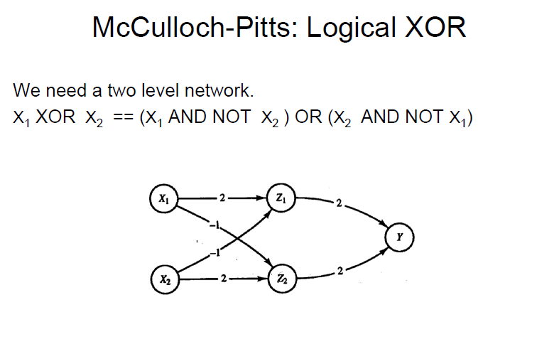

Slide 4
x1 | x2 | Not x1 | Not x2 | X1 and not x2 | X2 and not x1 | X1 and not x2 Or X2 and not x1
0 | 0 | 1 | 1 | 0 | 0 | 0
0 | 1 | 1 | 0 | 0 | 1 | 1
1 | 0 | 0 | 1 | 1 | 0 | 1
1 | 1 | 0 | 0 | 0 | 0 | 0

Slide 5
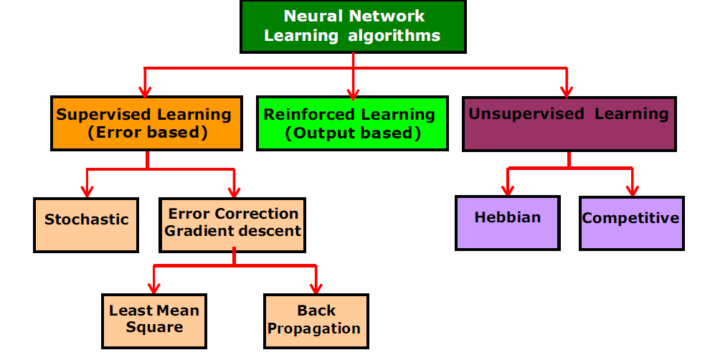
Classification of Learning Algorithms

Slide 6
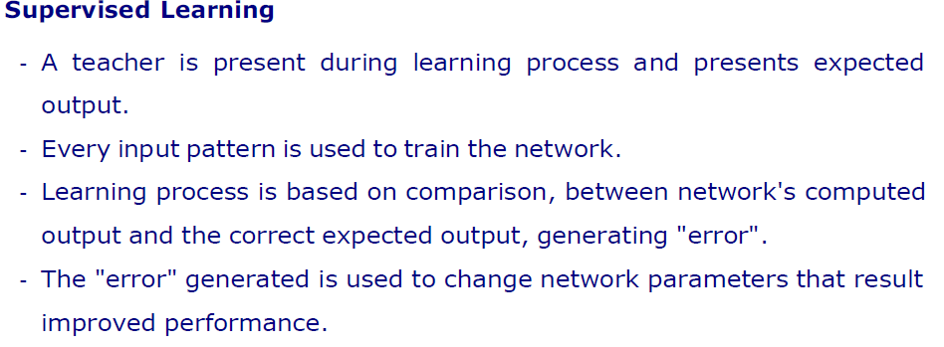
Classification of Learning Algorithms

Slide 7
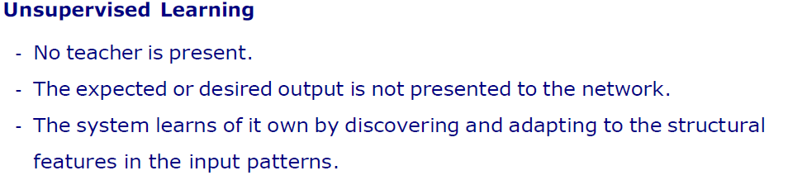
Classification of Learning Algorithms

Slide 8
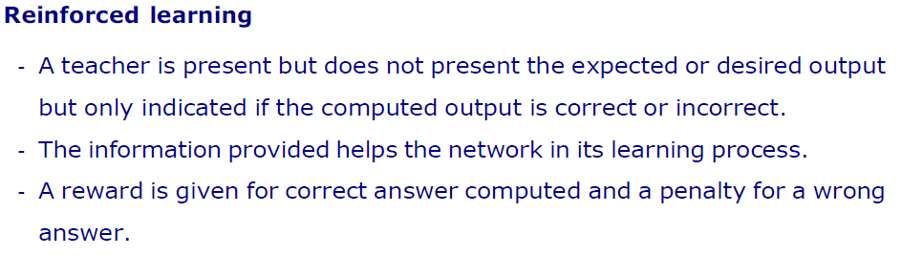
Classification of Learning Algorithms

Slide 9
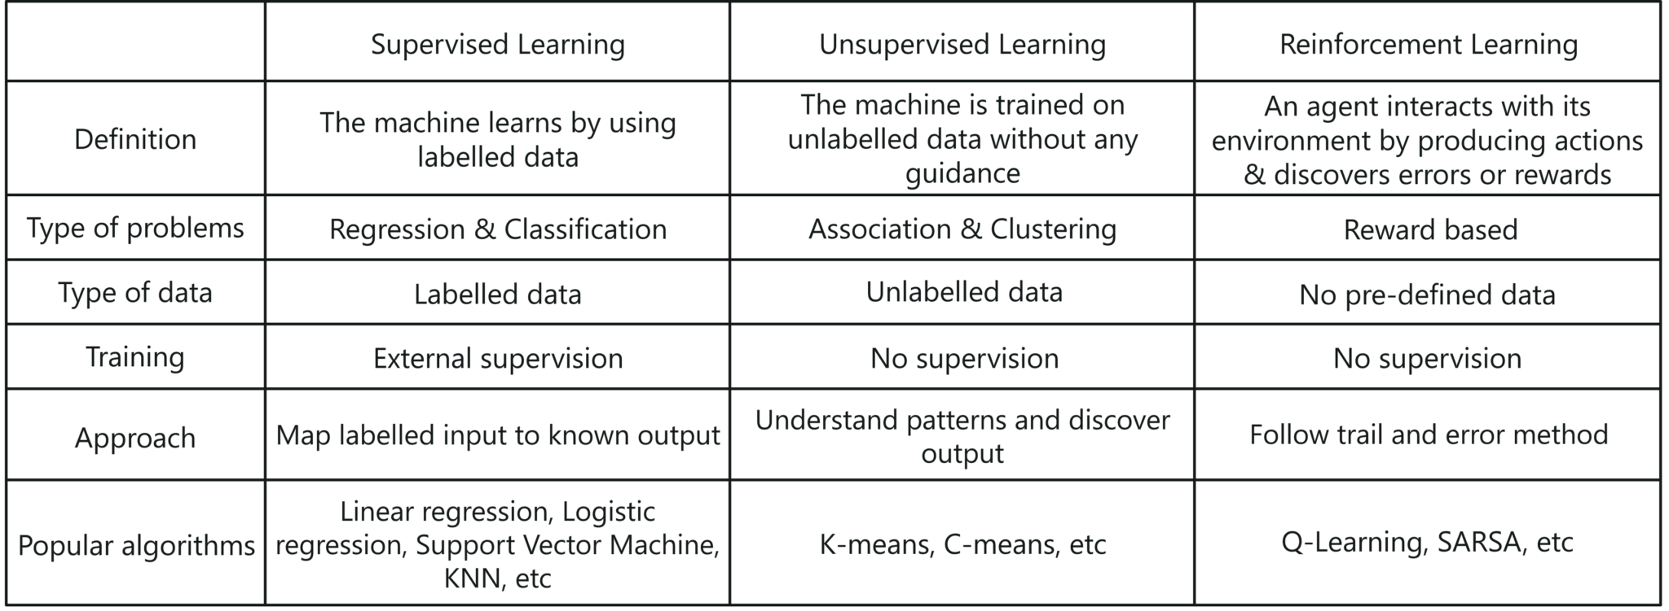
Classification of Learning Algorithms

Slide 10

12/12/14
CSE510, Lovely Professional University, Phagwara

